Slide 1
Instructor Notes
To the instructor:
This slide set has been prepared with both the highlights from the student text as well as notes from the text. The students will not be able to see the notes unless you provide them with the slide set. You can choose whether to provide that option.
The notes are best seen by directing the main presentation to the LCD projector and keeping the Notes view open on the instructor’s PC. You will find that stopping the presentation to do some kind of activity at least once every 20 minutes is critical to keeping PowerPoint from become tedious. Since different people have different presenting styles, it would be impossible to provide a clear timing structure. You should allow ample time for each slide, including stopping for activities.
In case you have not done this before, the instructor notes are found by pointing at Slide Show on the Menu Bar. Click on the Set Up Slide Show option and select Multiple Monitors → Show Presenter View.
Note: Presenter View also has a blackout button. Don’t be afraid to use it to interrupt the tedium of staring at an LCD presentation when doing activities.

Slide 2
Advanced AndroidTM Application Development, Fourth Edition Chapter 23 Working with Animation

Slide 3
Chapter 23 Overview
Animating Your Applications
Working with Different Interpolators
Animating Activity Launch
State Animations with Scenes and Transitions

Slide 4
Animating Your Applications
The Android platform supports several types of graphics animation:
Animated GIF images
Drawable animation (frame-by-frame animation)
View animation (tweened animation)
Property animation
Notes:
Animated GIFs store the animation frames in the image, and you simply include these GIFs as you would any other graphic-drawable resource. For drawable animation (frame-by-frame animation), the developer must provide all graphic frames of the animation. However, with view animation (or tweened animation), only a single graphic is needed, to which transforms can be programmatically applied. Property animation, or the modification of any object property over a certain time duration, was added in Android 3.0. The Android animation framework also supports numerous interpolators for different animation effects.

Slide 5
Working with Drawable Animation
You can think of drawable animation as a digital flipbook in which a series of similar images display on the screen in a sequence, each subtly different from the last.
When you display these images quickly, they give the illusion of movement.
This technique is called frame-by-frame animation and is often used on the Web in the form of animated GIF images.
Frame-by-frame animation is best used for complicated graphics transformations that are not easily implemented programmatically.

Slide 6
Working with Drawable Animation
Notes:
For example, we can create the illusion of a genie juggling gifts using a sequence of three images, as shown in this figure.
In each frame, the genie remains fixed, but the gifts are repositioned slightly. The smoothness of the animation is controlled by providing an adequate number of frames and choosing the appropriate speed with which to swap them.

Slide 7
Working with Drawable Animation
ImageView img = (ImageView)findViewById(R.id.ImageView1);
BitmapDrawable frame1 = (BitmapDrawable)getResources().
getDrawable(R.drawable.f1);
BitmapDrawable frame2 = (BitmapDrawable)getResources().
getDrawable(R.drawable.f2);
BitmapDrawable frame3 = (BitmapDrawable)getResources().
getDrawable(R.drawable.f3);
int reasonableDuration = 250;
AnimationDrawable mFrameAnimation = new AnimationDrawable();
mFrameAnimation.addFrame(frame1, reasonableDuration);
mFrameAnimation.addFrame(frame2, reasonableDuration);
mFrameAnimation.addFrame(frame3, reasonableDuration);
img.setBackground(mFrameAnimation);
Notes:
The code shown here demonstrates how to load three Bitmap resources (our three genie frames) and create an AnimationDrawable. We then set the AnimationDrawable as the background resource of an ImageView and start the animation.
setBackground() was added in API Level 16 and is used for adding the frame animation as the background.

Slide 8
Working with Drawable Animation
mAnimation.setOneShot(false);
Notes:
To make the animation loop continuously, we can call the setOneShot() method.

Slide 9
Working with Drawable Animation
mAnimation.start();
Notes:
To begin the animation, we call the start() method.

Slide 10
Working with Drawable Animation
mAnimation.stop();
Notes:
We can end our animation at any time using the stop() method.
Although we used an ImageView background in this example, you can use a variety of different View controls for animations. For example, you can instead use the ImageSwitcher view and change the displayed Drawable resource using a timer. This sort of operation is best done on a separate thread.

Slide 11
Working with Drawable Animation
Notes:
The resulting animation might look something like this figure—you just have to imagine it moving.

Slide 12
Working with View Animations
With view animations (also called tween animations), you can provide a single Drawable resource as a Bitmap graphic, a ShapeDrawable, a TextView, or any other type of View object and the system will automatically render the intermediate frames of the animation.
Android provides tweening support for several common image transformations, including alpha, rotate, scale, and translate animations.
You can apply tweened animation transformations to any View, whether it is an ImageView with a Bitmap, a ShapeDrawable, or a layout such as a TableLayout.

Slide 13
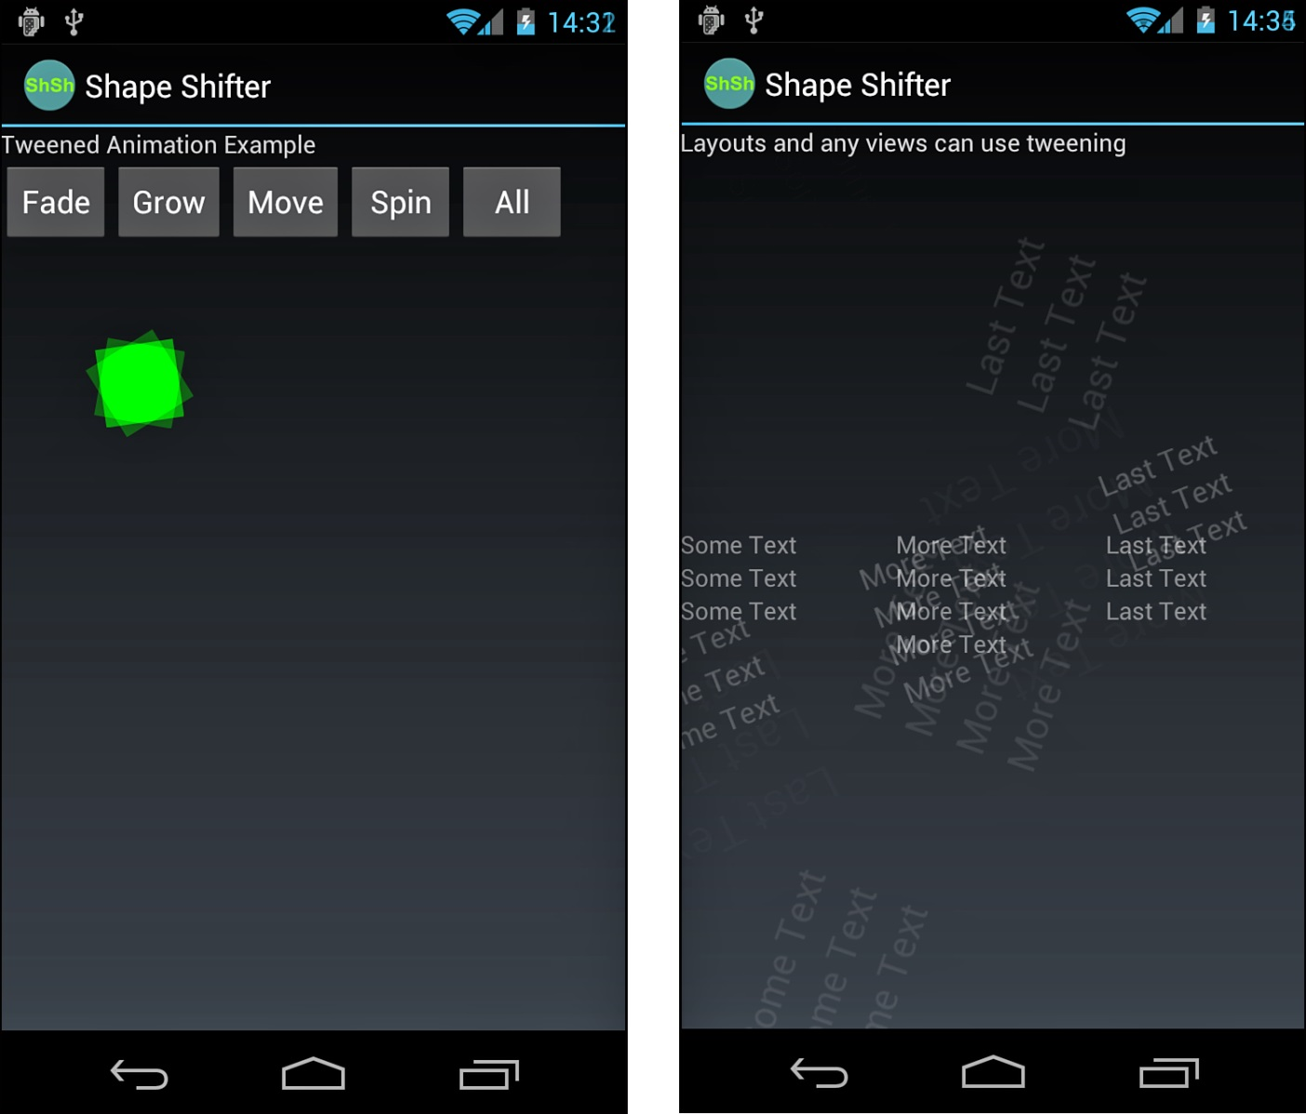
Working with View Animations
Notes:
Rotating a green rectangle ShapeDrawable (left) and a TableLayout (right).

Slide 14
Defining Tweening Transformations
You can define tweening transformations as XML resource files or programmatically.
All tweened animations share some common properties, including when to start, how long to animate, and whether to return to the starting state upon completion.

Slide 15
Defining Tweened Animations as XML Resources
<?xml version="1.0" encoding="utf-8" ?>
<set xmlns:android="http://schemas.android.com/apk/res/android"
android:shareInterpolator="false">
<rotate
android:fromDegrees="0"
android:toDegrees="360"
android:pivotX="50%"
android:pivotY="50%"
android:duration="5000" />
</set>
Notes:
You can store animation sequences as specially formatted XML files in the /res/animator/ resource directory. For example, the resource file called /res/animator/spin.xml, shown here, describes a simple 5-second rotation.

Slide 16
Defining Tweened Animations Programmatically
import android.view.animation.RotateAnimation;
...
RotateAnimation rotate = new RotateAnimation(
0, 360, RotateAnimation.RELATIVE_TO_SELF, 0.5f,
RotateAnimation.RELATIVE_TO_SELF, 0.5f);
rotate.setDuration(5000);
Notes:
You can programmatically define these animations. The different types of transformations are available as classes in the android.view.animation package. For example, you can define the aforementioned rotation animation as shown here.

Slide 17
Defining Simultaneous and Sequential Tweened Animations
<?xml version="1.0" encoding="utf-8" ?>
<set xmlns:android=http://schemas.android.com/apk/res/android
android:shareInterpolator="false">
<scale
android:pivotX="50%"
android:pivotY="50%"
android:fromXScale="1.0"
android:fromYScale="1.0"
android:toXScale="2.0"
android:toYScale="2.0"
android:duration="2500" />
<scale
android:startOffset="2500"
android:duration="2500"
android:pivotX="50%"
android:pivotY="50%"
android:fromXScale="1.0"
android:fromYScale="1.0"
android:toXScale="0.5"
android:toYScale="0.5" />
</set>
Notes:
Animation transformations can happen simultaneously or sequentially when you set the startOffset and duration properties, which control when an animation starts and how long it takes to complete. You can combine animations into the <set> tag (programmatically, using AnimationSet) to share properties.
For example, this animation resource file /res/animator/grow.xml includes a set of two scale animations. First, we take 2.5 seconds to double in size, and then at 2.5 seconds, we start a second animation to shrink back to our starting size.

Slide 18
Loading Animations
import android.view.animation.Animation;
import android.view.animation.AnimationUtils;
...
ImageView iView = (ImageView)findViewById(R.id.ImageView1);
iView.setImageResource(R.drawable.green_rect);
Animation an = AnimationUtils.loadAnimation(this, R.anim.grow);
iView.startAnimation(an);
Notes:
Loading animations is made simple using the AnimationUtils helper class. This code loads an animation XML resource file called /res/animator/grow.xml and applies it to an ImageView whose source resource is a green rectangle ShapeDrawable.

Slide 19
Loading Animations
class MyAnimationListener implements Animation.AnimationListener {
public void onAnimationEnd(Animation animation) {
// Do at end of animation
}
public void onAnimationRepeat(Animation animation) {
// Do each time the animation loops
}
public void onAnimationStart(Animation animation) {
// Do at start of animation
}
}
Notes:
We can listen for Animation events, including the animation start, end, and repeat events, by implementing an AnimationListener class, such as the MyAnimationListener class shown here.

Slide 20
Loading Animations
an.setAnimationListener(new MyAnimationListener());
Notes:
You can then register your AnimationListener like this.

Slide 21
Exploring the Four Different Tweening Transformations
Now let’s look at each of the four types of tweening transformations individually.
These types are
Transparency changes (alpha)
Rotations (rotate)
Scaling (scale)
Movement (translate)

Slide 22
Working with Alpha Transparency Transformations
<alpha
android:fromAlpha="0.0"
android:toAlpha="1.0"
android:duration="5000">
</alpha>
Notes:
Transparency is controlled using alpha transformations. Alpha transformations can be used to fade objects in and out of view or to layer them on the screen.
Alpha values range from 0.0 (fully transparent or invisible) to 1.0 (fully opaque or visible). Alpha animations involve a starting transparency (fromAlpha) and an ending transparency (toAlpha).
This XML resource file excerpt defines a transparency-change animation, taking 5 seconds to fade in from fully transparent to fully opaque.
Programmatically, you can create this same animation using the AlphaAnimation class within the android.view.animation package.

Slide 23
Working with Rotating Transformations
<rotate
android:fromDegrees="0"
android:toDegrees="360"
android:pivotX="50%"
android:pivotY="50%"
android:duration="5000" />
Notes:
You can use rotation operations to spin objects clockwise or counterclockwise around a pivot point in the object’s boundaries.
Rotations are defined in terms of degrees. For example, you might want an object to make one complete clockwise rotation. To do this, you set the fromDegrees property to 0 and the toDegrees property to 360. To rotate the object counterclockwise instead, you set the toDegrees property to –360.
By default, the object pivots around the (0,0) coordinate, or the top-left corner of the object. This is great for rotations such as those of a clock’s hands, but much of the time, you want to pivot from the center of the object. You can do this easily by setting the pivot point, which can be a fixed coordinate or a percentage.
The XML resource file excerpt shown here defines a rotation animation, taking 5 seconds to make one full clockwise rotation, pivoting from the center of the object.
Programmatically, you can create this same animation using the RotateAnimation class in the android.view.animation package.

Slide 24
Working with Scaling Transformations
<scale
android:pivotX="50%"
android:pivotY="50%"
android:fromXScale="1.0"
android:fromYScale="1.0"
android:toXScale="2.0"
android:toYScale="2.0"
android:duration="5000" />
Notes:
You can use scaling operations to stretch objects vertically and horizontally. Scaling operations are defined as relative scales. Think of the scale value of 1.0 as 100 percent, or full size. To scale to half size, or 50 percent, set the target scale value to 0.5.
You can scale horizontally and vertically on different scales or on the same scale (to preserve aspect ratio). You need to set four values for proper scaling: starting scale (fromXScale, fromYScale) and target scale (toXScale, toYScale). Again, you can use a pivot point to stretch your object from a specific (x,y) coordinate such as the center or another coordinate.
This XML resource file excerpt defines a scaling animation, taking 5 seconds to double an object’s size, pivoting from the center of the object.
Programmatically, you can create this same animation using the ScaleAnimation class within the android.view.animation package.

Slide 25
Working with Moving Transformations
<translate
android:toYDelta="-100"
android:fillAfter="true"
android:duration="2500" />
Notes:
You can move objects around using translate operations. Translate operations move an object from one position on the (x,y) coordinate to another position.
To perform a translate operation, you must specify the change, or delta, in the object’s coordinates. You can set four values for translations: starting position (fromXDelta, fromYDelta) and relative target location (toXDelta, toYDelta).
This XML resource file excerpt defines a translate animation, taking 5 seconds to move an object up (negative) by 100 on the y axis. We also set the fillAfter property to be true, so the object doesn’t “jump” back to its starting position when the animation finishes.
Programmatically, you can create this same animation using the TranslateAnimation class in the android.view.animation package.

Slide 26
Working with Property Animation
Introduced in Android API Level 11 and refined in Android API Level 12, property animation is the capability to animate any object property over time.
The property animation system is much more flexible and robust than the features available in view animations.
Unlike view animations, when property animation is used, the properties of the object (such as a View control) are actually modified over the course of time, as opposed to just drawn with the underlying object remaining unchanged.

Slide 27
Working with Property Animation
Property animation can be configured in the following ways:
Animations can be applied to value or object types.
Animations can use the various interpolators available on the platform.
Animations can be defined in sets, with multiple attributes changing simultaneously or in sequence.
Animations are created separately from the target objects to which they are applied, and they can be reused.
Animation duration, repeat count (a number or infinite), repeat behavior (repeat from the beginning or reverse), and other animation characteristics can be set as needed.

Slide 28
Working with Property Animation
There are several important classes you’ll want to be aware of for property animation:
The ValueAnimator class (android.animation.ValueAnimator)
The ObjectAnimator class (android.animation.ObjectAnimator)
The ViewPropertyAnimator class (android.view.ViewPropertyAnimator)
The Animator.AnimatorPauseListener interface
The RectEvaluator class
There are a number of evaluator classes (android.animation.*), such as IntEvaluator, FloatEvaluator, ArgbEvaluator, and TimeAnimator.
Notes:
The ValueAnimator class (android.animation.ValueAnimator) is the base class for all property animations.
The ObjectAnimator class (android.animation.ObjectAnimator) is the convenience class for animating a specific target object and property. This is the class you will use most frequently for animating properties on objects like View controls.
The ViewPropertyAnimator class (android.view.ViewPropertyAnimator) enables optimized and easy animation for View objects. The animate() method of View objects provides access to this class, and its performance may be better than that of alternative methods. In fact, the results may be hardware accelerated.
The Animator.AnimatorPauseListener interface was added in API Level 19 and is used for receiving animation notifications. The onAnimationPause() method responds to paused animations, and the onAnimationResume() method responds to resumed animations.
The RectEvaluator class, added in API Level 18, is used to interpolate coordinates of a rectangle.
There are a number of evaluator classes (android.animation.*), such as IntEvaluator, FloatEvaluator, ArgbEvaluator, and TimeAnimator. These enable you to animate any type of property an object can have by defining how to calculate changes in the property over time.

Slide 29
Defining Property Animations as XML Resources
Property animation sets can be configured via XML, much like view animations.
You can store property animation sequences as specially formatted XML files in the /res/animator/ resource directory.

Slide 30
Defining Property Animations as XML Resources
A property animation has a number of attributes, including
A duration
A property name
The repeat count
The repeat mode
The value start and stop points
The value type
Notes:
A duration: The amount of time it takes, in milliseconds, for the animation to complete. This value is set with the android:duration attribute.
A property name: The name of the property to be modified in the animation. This value is set with the android:propertyName attribute. Only properties with getter/setter methods that return int or float should be used, such as set<propertyName> or get<propertyName>.
The repeat count: The number of times this animation should take place. This value is set with the android:repeatCount attribute. If you want the animation to repeat without stopping, use –1.
The repeat mode: The way the animation repeats. This value is set with the android:repeatMode attribute. If you want the animation to repeat by resetting and starting from the beginning, use repeat. If you want the animation to reverse and go back to where it started, use reverse.
The value start and stop points: The range of values between which to animate the value of the property. These values are set with the android:valueFrom and android:valueTo attributes. If you want to animate from the current value of the property, you need not specify it with the android:valueFrom attribute.
The value type: This is the data type of the property being animated on. This value is set with the android:valueType attribute. XML files support both intType and floatType. Other types, such as color values, can be set programmatically.

Slide 31
Defining Property Animations as XML Resources
<?xml version="1.0" encoding="utf-8" ?>
<set xmlns:android="http://schemas.android.com/apk/res/android"
android:ordering="together" >
<objectAnimator
android:duration="2500"
android:propertyName="alpha"
android:repeatCount="-1"
android:repeatMode="reverse"
android:valueFrom="0"
android:valueTo="1"
android:valueType="floatType" />
<objectAnimator
android:duration="7500"
android:propertyName="backgroundColor"
android:repeatCount="-1"
android:repeatMode="reverse"
android:valueFrom="#2E0854"
android:valueTo="#BF5FFF" />
</set>
Notes:
For example, the resource file shown here called /res/animator/blinky_anim.xml describes a simple property animation set that modifies the alpha and backgroundColor properties of an object over time.
This animation set contains two animations that are performed simultaneously. The first animates the alpha property, causing the object to fade in and out of view over the course of 5 seconds, indefinitely, because a repeatCount of –1 means to animate continuously and the repeatMode causes the animation to reverse itself each time. The second animation happens more slowly, changing the backgroundColor attribute of the object between two purple colors, as specified in the valueFrom and valueTo attributes of the animation configuration.

Slide 32
Defining and Modifying Property Animations Programmatically
AnimatorSet set = (AnimatorSet) AnimatorInflater.loadAnimator(this,
R.animator.blinky_anim);
ArrayList<Animator> animations = set.getChildAnimations();
for (Animator animator : animations) {
if (animator instanceof ObjectAnimator) {
ObjectAnimator anim = (ObjectAnimator) animator;
if (anim.getPropertyName().compareTo("backgroundColor") == 0) {
anim.setEvaluator(new ArgbEvaluator());
}
}
}
set.setInterpolator(new LinearInterpolator());
Notes:
You can also programmatically define property animations. The property animation classes are available in the android.animation package. There are also times when you may need to modify an animation defined in XML. For example, here we load the animation set that was defined earlier in XML and set the value type of the objectAnimator for the backgroundColor attribute to an ArgbEvaluator, which can’t be defined via XML.

Slide 33
Starting Property Animations Programmatically
TextView tv = (TextView) findViewById(R.id.myText);
set.setTarget(tv);
set.start();
Notes:
To use a property animation, you must attach it to an object of your choice. For example, we can attach the property animation we just created to a TextView control (defined in the layout) and start the animation.
Here, we attach the property animation to a View using the setTarget() method and then begin animating with the start() method.

Slide 34
Starting Property Animations Programmatically
tv.animate().translationXBy(75f).rotationXBy(720).setDuration(1250);
layout.animate().scaleX(0.5f)
.scaleY(0.5f)
.setInterpolator(new BounceInterpolator())
.setDuration(1500);
Notes:
When you are just animating properties of a View control, it is often more efficient and usually easier to use the animate() method. Starting with API Level 12, all View objects have an animate() method that returns a ViewPropertyAnimator object. Through this object, a subset of properties can be animated easily and efficiently.
The first one shows a TextView being moved horizontally by 75 pixels and rotated around the x axis, both of which take place over 1250 milliseconds. The rotation around the x axis is, indeed, a three-dimensional rotation. The second example shows an entire layout—including all buttons, images, text, indeed, all children—being scaled to 50 percent of its original size with a bounce interpolator, over a duration of 1500 milliseconds.

Slide 35
Starting Property Animations Programmatically
Notes:
Here is an example of a ViewPropertyAnimator in action.

Slide 36
Working with Different Interpolators
The interpolator determines the rate at which an animation happens in time.
Interpolators apply to both view and property animations.
A number of different interpolators are provided as part of the Android SDK framework, including
AccelerateDecelerateInterpolator
AccelerateInterpolator
AnticipateInterpolator
AnticipateOvershootInterpolator
BounceInterpolator
CycleInterpolator
DecelerateInterpolator
LinearInterpolator
OvershootInterpolator
You can specify the interpolator used by an animation programmatically using the setInterpolator() method or in the animation XML resource using the android:interpolator attribute.
Notes:
AccelerateDecelerateInterpolator: Animation starts slowly, speeds up, and ends slowly.
AccelerateInterpolator: Animation starts slowly and then accelerates.
AnticipateInterpolator: Animation starts backward, and then flings forward.
AnticipateOvershootInterpolator: Animation starts backward, flings forward, overshoots its destination, and then settles at the destination.
BounceInterpolator: Animation “bounces” into place at its destination.
CycleInterpolator: Animation is repeated a certain number of times, smoothly transitioning from one cycle to the next.
DecelerateInterpolator: Animation begins quickly and then decelerates.
LinearInterpolator: Animation speed is constant throughout.
OvershootInterpolator: Animation overshoots its destination, and then settles at the destination.

Slide 37
Animating Activity Launch
API Level 16 introduced the new ActivityOptions class which allows you to animate an Activity launch using custom or zoom animations.
There are three animation methods available for this class: makeCustomAnimation(), makeScaleUpAnimation(), and makeThumbnailScaleUpAnimation().
The custom method allows you to use an animation resource file for controlling the animation.
The scale-up method allows you to choose the location on the screen where you want the animation to originate from, and the thumbnail scale-up method allows you to choose a Bitmap object to scale up from a particular location on the screen.

Slide 38
State Animations with Scenes and Transitions
Many applications require different UI states at particular usability points within an application.
Certain visual components of a particular state are frequently reused throughout the user flow within the application, but not all components are needed across different states.
The new android.transition framework, introduced with Android KitKat (API Level 19), is a way to define different scene states of your UI, and to animate between those defined states using definable transitions.

Slide 39
State Animations with Scenes and Transitions
Scene state transitions are generally accomplished in the following manner:
Begin with a UI component state ViewGroup that needs animating.
Determine the next Scene layout to transition to.
Determine the transition type for the animation such as Fade or ChangeBounds and use a TransitionManager to manage the scene transition.
Perform the transition using the go() or transitionTo() method and include the Scene for transitioning to.

Slide 40
State Animations with Scenes and Transitions
You may also define transitions using XML files included within your resources directory.
These files would reside under res/transition and require including <transition> and <transitionManager> tag elements for controlling the state animations between scenes.

Slide 41
Chapter 23 Summary
We have learned how to animate applications.
We have learned how to work with different interpolators.
We have learned about animating an Activity launch.
We have learned about state animations with scenes and transitions.
Notes:
Class homework assignment: Chapter Quiz Questions and Exercises listed at the end of the chapter.

Slide 42
References and More Information
Android SDK Reference documentation on the android.animation package:
http://d.android.com/reference/android/animation/package-summary.html
Android SDK Reference documentation on the android.view.animation package:
http://d.android.com/reference/android/view/animation/package-summary.html
Android API Guides: “Animation and Graphics”:
http://developer.android.com/guide/topics/graphics/index.html
Android Training: “Adding Animations”:
http://developer.android.com/training/animation/index.html

Slide 43
References and More Information
Android SDK Reference documentation on the ActivityOptions package:
http://d.android.com/reference/android/app/ActivityOptions.html
Android SDK Reference documentation on the TransitionManager package:
http://d.android.com/reference/android/transition/TransitionManager.html
Android SDK Reference documentation on the Transition package:
http://d.android.com/reference/android/transition/Transition.html
YouTube Android Developers Channel: “DevBytes: ListView Expanding Cells Animation”:
http://www.youtube.com/watch?v=mwE61B56pVQ

